Slide 1

SAMP : AGROTECH
A HEALTH-TECH COMPANY

Slide 2
problem statement title:
Create a soil health monitoring system using IoT sensors and data analytics
team name : TEAM - “SAMP”
Team leader name : VED PATEL
Team Member name : NANDAN VAKANI
theme name :AGRICULTURE TECHNOLOGY

Slide 3
Create a soil health monitoring system using IoT sensors and data analytics
Soil health is crucial for sustainable agriculture, as it directly impacts crop yields, water quality, and ecosystem balance. Traditional soil testing methods are time-consuming, labor-intensive, and often provide limited insights. This problem statement seeks innovative solutions for real-time soil health monitoring using

Slide 4
1. IoT (Internet of Things) sensors
2. Data analytics
Deploy sensors to measure parameters
Develop algorithms
4. Food Waste Reduction
3. Limited Access to Finance
Innovative solutions to reduce food waste
To help farmers to built their new income resource

Slide 5
Goals:
1. Enable farmers to make data-driven decisions
2. Optimize fertilizer and water usage
3. Detect early warnings for soil-borne diseases4. Promote sustainable soil management practices
Potential features:
1. Real-time soil health dashboard2. Automated alerts for critical conditions3. Personalized recommendations for soil improvement4. Integration with existing farm management systems5. Scalability for large-scale agricultural operations

Slide 6
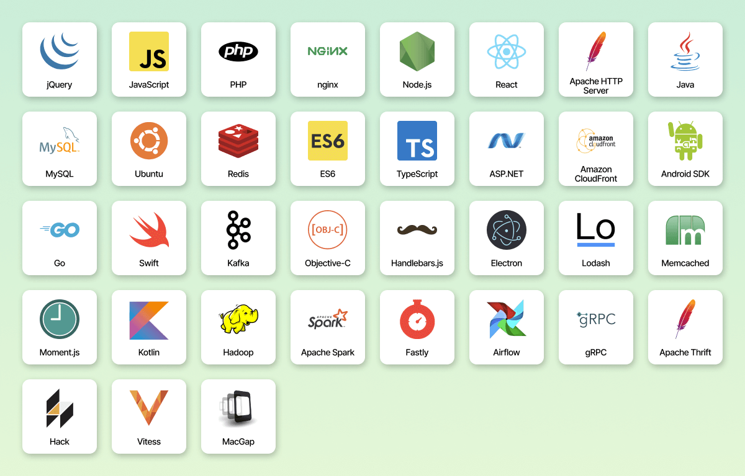
TECHNOLOGY STACK
IDEA / APPROACH DETAILS
Here's a detailed approach for a soil health monitoring system using IoT sensors and data analytics:
System Components:
IoT Sensors:- Soil Moisture Sensors - Temperature Sensors - pH Sensors - Nutrient Sensors (NPK) - Salinity Sensors
Data Acquisition and Transmission:- Microcontrollers (e.g., Arduino, Raspberry Pi) - Wireless Communication Modules (e.g., Wi-Fi, LoRaWAN)
Data Analytics: - Cloud-based Data Platform (e.g., AWS, Google Cloud) - Machine Learning Algorithms - Data Visualization Tools4. User Interface: - Web-based Dashboard - Mobile App

Slide 7
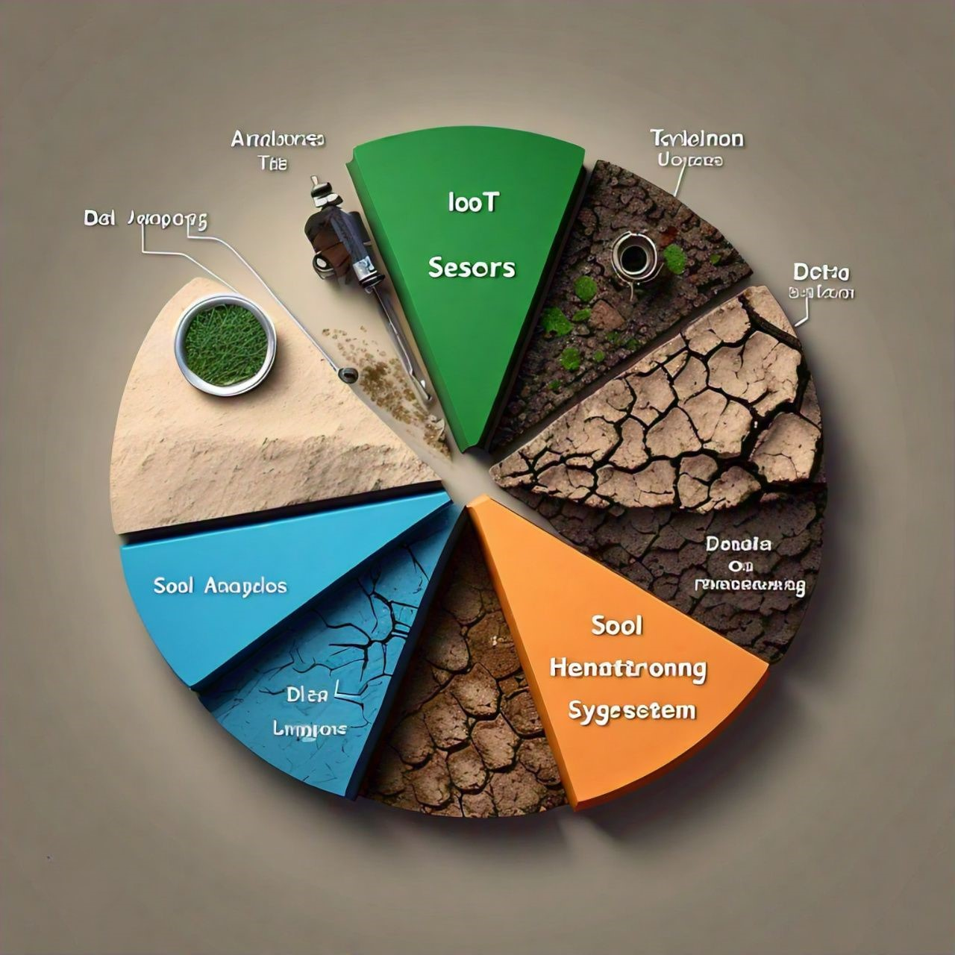
Benefits:
1. Real-time soil health monitoring
2. Data-driven decision making
3. Optimized resource allocation
4. Improved crop yields
5. Reduced water and fertilizer consumption6. Enhanced soil sustainability
Future Enhancements:
1. Integration with weather forecasts
2. Incorporation of drone-based aerial imaging
3. Expansion to other environmental factors (e.g., air quality, noise pollution)
4. Development of predictive models for soil health forecasting

Slide 8
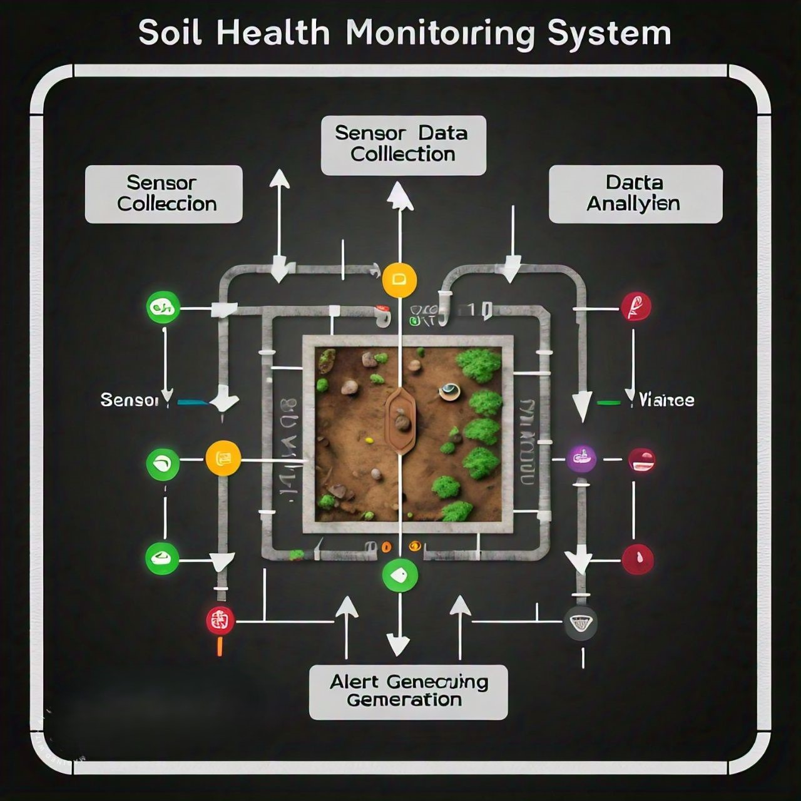
SYSTEM WORKFLOW
1. Sensor Deployment: Install IoT sensors in the soil to collect data on moisture, temperature, pH, nutrients, and salinity.
2. Data Collection: Sensors transmit data to microcontrollers, which forward it to the cloud-based data platform.
3. Data Processing: Machine learning algorithms analyze the data to identify trends, patterns, and anomalies.
4. Insights Generation: System provides actionable insights on soil health, including: - Moisture levels - Nutrient deficiencies - pH imbalances - Salinity levels - Temperature fluctuations
5. Notification and Alert System: Sends alerts to farmers/agriculturists when soil health parameters exceed threshold values.
6. Data Visualization: Presents data insights through interactive dashboards and mobile apps.7. Decision Support System: Offers recommendations for optimized irrigation, fertilization, and pest management.

Slide 9
Thanks
Do you have any questions?
nandanvakani@gmail.com
ved48795@gmail.com
Leader X ID : vedpatel27_1
Member 1 X ID : NandanVakani21

